Slide 1
Community Mobilization: Garnering public support for your housing plan
Prepared for 2019 GICH Fall Retreat
Jermaine Durham

Slide 2
Outline
The Community Development Process
Understanding Social Capital
Public Participation and Community Mobilization
Strategies to Enhance Participation & Mobilization
Conclusion

Slide 3
The Community Development Process

Slide 4
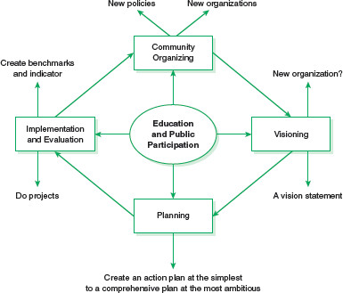
Community Asset Development Process
Community development is a planned effort to build assets that increase the capacity of residents to improve the quality of life.
  Asset-based approach relies on build on existing resources and strengths to guide the community planning effort
  Addresses power relations within communities through broad-based support and participation
  Closely related to social capital theory

Slide 5
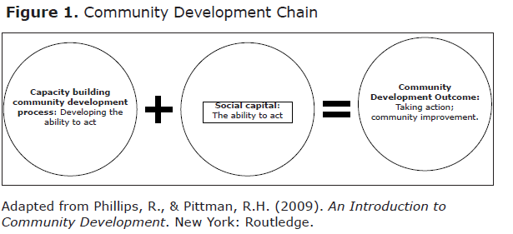
Community Development Chain

Slide 6
GICH Housing Teams
GICH Housing Team
Neighborhood(s)
Business Community
Local Government
GICH Housing teams both “internal” and “external” entities at the neighborhood level
GICH housing teams serve as a nexus between local residents, business community and local government
Success of housing teams rest in the effectiveness of communicating and building social capital between these entities

Slide 7
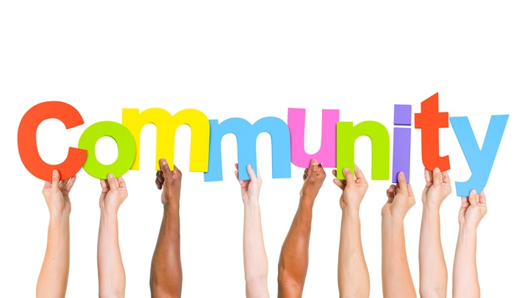
GICH Housing Teams as Community Based Organizations
Community Based Organizations (CBOs)
  Rooted in place and have extensive contacts and information about neighborhoods in their communities
  Their primary mission is aimed at the locality; they emphasize the importance of place over other goals
  In ideal situations, local residents have levels of control of CBOs
Four critical functions of CBOs
  They create power as they gather resources
  They provide continuing sustained action over time
  They create expertise through their experience
  Able to react quickly to various opportunities and issues

Slide 8
Various Types of CBOs
Community Development Corporations
Economic Development Corporations
Neighborhood Associations
Youth Organizations
Faith-Based Organizations
Community Foundations
GICH Housing Teams

Slide 9
Community Organizing vs. Community Building
Community Organizing: Seeks to mobilize the interests on the disempowered and organize them into effective units of collective action so as to change the balance of power in the community
Community Building: Seeks to enhance social ties and identification of shared interests among community members. Goal is to build relationships among local residents and organizations. Believes in the value of social capital development

Slide 10
Understanding Social Capital

Slide 11
What is social capital?
Social capital is about the value of social networks, bonding similar people and bridging between diverse people, with norms of reciprocity. (Dekker and Uslaner, 2001; Uslaner, 2001)
Social capital is the resource that comes from our investment in relationships.
Includes aspects of the social structure (trust, norms, social networks) that facilitate collective action.
Does not exist within individuals, rather it exists within and is inseparable from interaction between and among individuals. (Coleman, 1998)

Slide 12


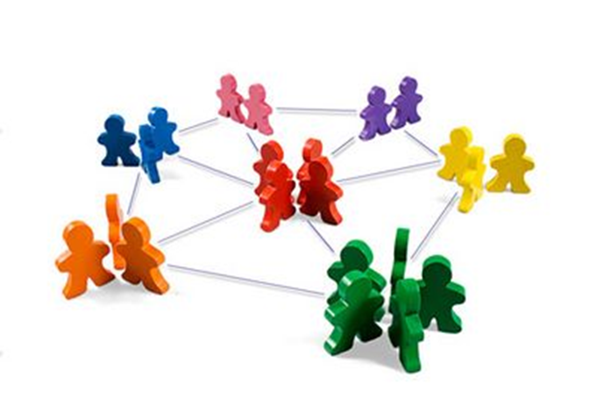
Social capital
Unlike other forms of capital, social capital has an inherently expansionary dynamic, growing the more that it is used.
Successful social capital transactions build trust and a foundation of reciprocity that leads to further transactions.

Slide 13
Types of social capital
Bridging
Bridging capital – brings together people or groups who did not previously know each other, establishes new social ties, access to new information, access to additional social networks
Connects people to resources and opportunities, helps people to advance socioeconomically (get ahead)
Weak ties
Bonding
Bonding social capital - forms among close family, friends and neighbors, usually in close proximity, who have a high degree of trust and who are similar demographically.
Helps people “get by”
Strong ties

Slide 14
Public Participation & Community Mobilization

Slide 15

Public Participation vs. Outcomes
Public participation argument: The experience of participating in solving local issues will build capacity of residents, making future problem solving more effective
Outcome argument: Public participation is merely a means to an end and the ultimate goal of community development is to improve quality of life
GICH teams are involved in both these aspects of community development and must work to enhance both to maximize effectiveness

Slide 16

Defining Public Participation
Refers to the involvement of citizens and non-citizens in the decision making processes that directly or indirectly effect their neighborhoods and/or communities
Allows various stakeholders who are not officially members of housing team opportunities to shape the decision making process

Slide 17
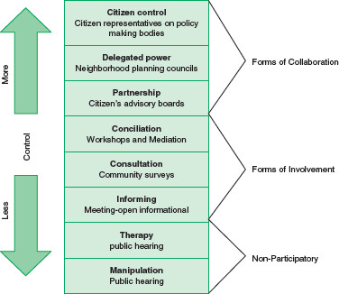
Ladder of Participation

Slide 18
Community Mobilization
Involves community residents taking direct action to protest or support local projects, policies, or programs. Gets people involved directly in community problem solving
Community mobilization is essentially a process for reaching out to different sectors of a community and creating partnerships in order to focus on, and ultimately address community problems
Identifying the capacities of residents, organizations and institutions
  All people have the capacity to contribute. Do not overlook youth, seniors, people with disabilities
Associations and organizations can facilitate mobilization
Relationship building to implement goals

Slide 19

Benefits of public participation & mobilization
Reflects the democratic principles that our society is built upon
Enhances social capital among GICH team and other groups is the community
Helps build capacity of local residents
Residents become more knowledgeable about issues and planning process
Inclusiveness allows residents to weigh in on how housing teams perceive neighborhood problems
Residents/government officials are more likely to support housing initiative that includes their buy-in.
Plans without public support can isolate local residents and/or local government

Slide 20
Challenges to Public Participation & Mobilization
Can increase the complexity if decision making
Involving more members of the public in decision making can be time-consuming and require additional resources
Can slow an organization’s reaction time in situations where quick decisions need to be made
Residents may not be interested or have the capacity to participate

Slide 21
Strategies to Enhance Public Participation and Mobilization

Slide 22

How to get public engaged in housing team activities
Community clean up days
Resident/local government attend housing team meetings
Organizing local neighborhood residents
  Resident advisory council; neighborhood association
Foster collaboration with resident organizations
Maintain consistent interaction with elected officials
Leveraging Social media
Utilize current community gatherings to promote housing initiative
Housing Fairs & Expos

Slide 23
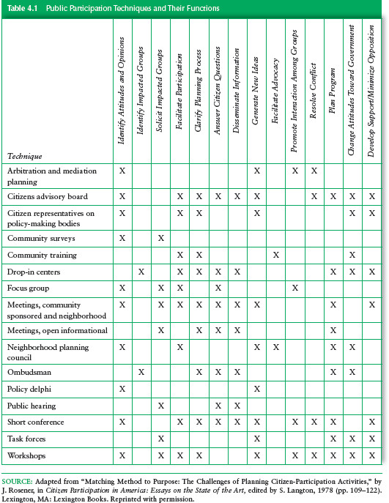
Public Participation Techniques and their Functions

Slide 24
Conclusion

Slide 25
Things housing teams should consider
Information
Are residents organized and if so, what are these forms of organizations (i.e. churches, neighborhood association, community center etc.)?
How much do we know about the residents in targeted neighborhoods?
How will our housing plan impact neighborhood residents?
What does the local government know about out effort?
Communication
Do residents have knowledge about the actions of our housing team? How do we enhance this?
How can your housing team leverage the community organizations to inform public about planning activities?
How many residents/local gov. representatives are involved in our housing team meetings?
Engagement
What level of involvement does the greater community have in your housing team activities?
What roles do community members play in housing team activities

Slide 26
Questions?

